Slide 1
Human Gaussian
Enviroment setup(Github)

Slide 2
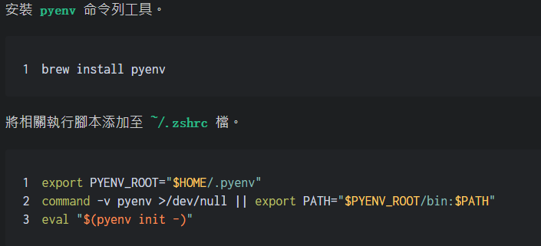
Python version(3.10.13)

Slide 3
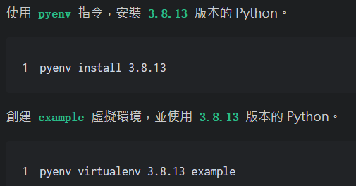
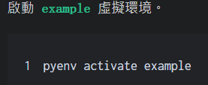
Python version(3.10.13) cont.
3.10.13
3.10.13
3.10.13
3.10.13

Slide 4
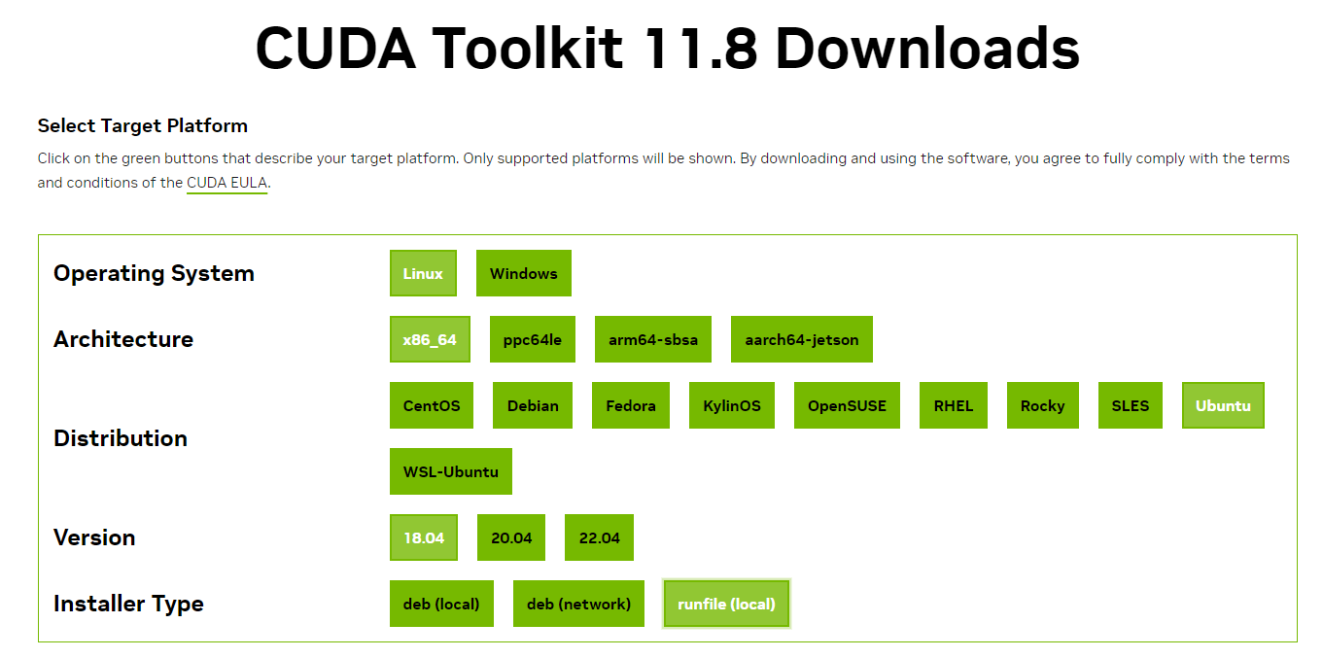
CUDA version(11.8)
Link

Slide 5
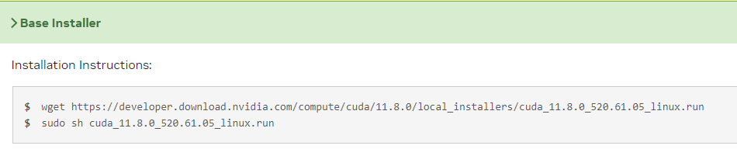
CUDA version(11.8)​ cont.

Slide 6
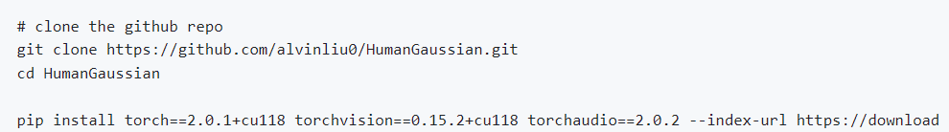
Package installation
Then modify the requirement.txt files:
Original:
Modified:

Slide 7
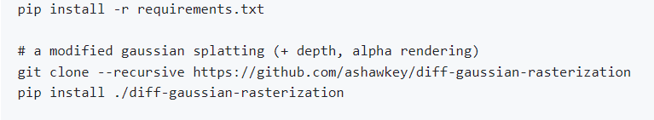
Package installation​ cont.
Then modify the following files(HumanGaussian/threestudio/models/guidance/models/unet_rgbdepth.py):
Original:
Modified:

Slide 8

Move tensor to cuda
Change code in unet_rgbdepth.py to move the tensor to cuda:
Original:
Append one line like the following:
Same way to change the folowing line of code in original file:
924,970,974,989,999,1018,1057,1067,1088,1116,1127,1146,1157,1174,1190,1191,1192,1198,1199,1200

Slide 9
Other setup
After the package installation and code changing, about other pretrained Models and the related route setting,see the github README content.

Slide 10
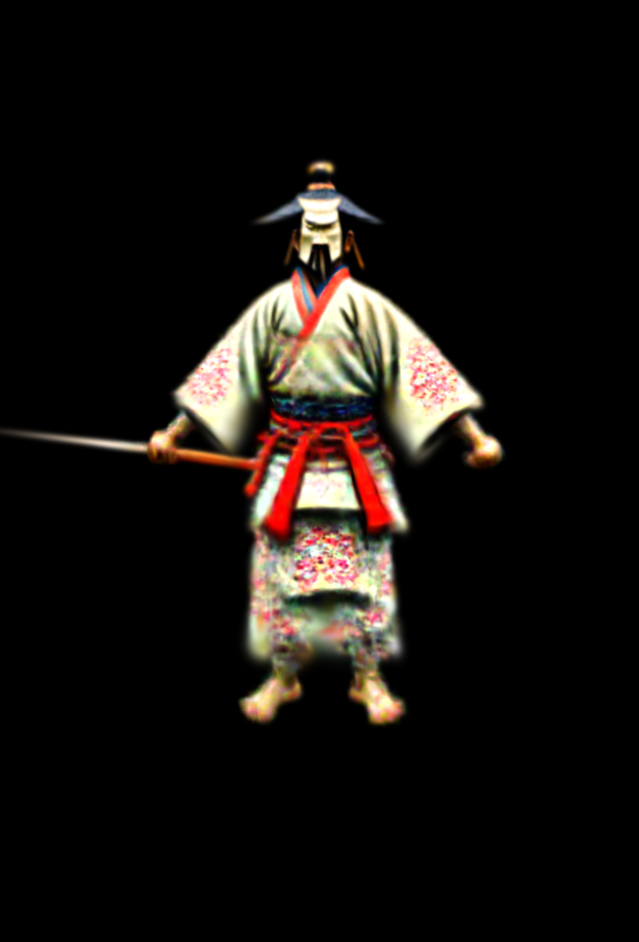
Common usage
Training the model:
python launch.py --config configs/test.yaml --train --gpu 0 system.prompt_processor.prompt="A boy with a beanie wearing a hoodie and joggers"
The result will be saved in folder "save"
A Japanese samurai

Slide 11
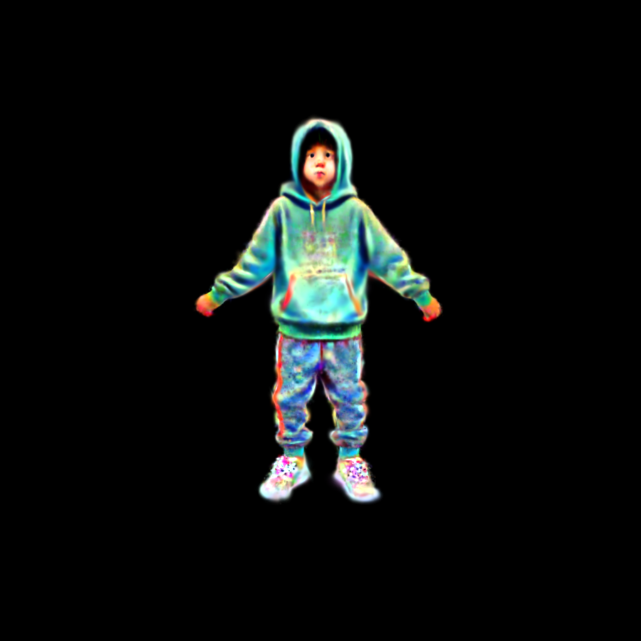
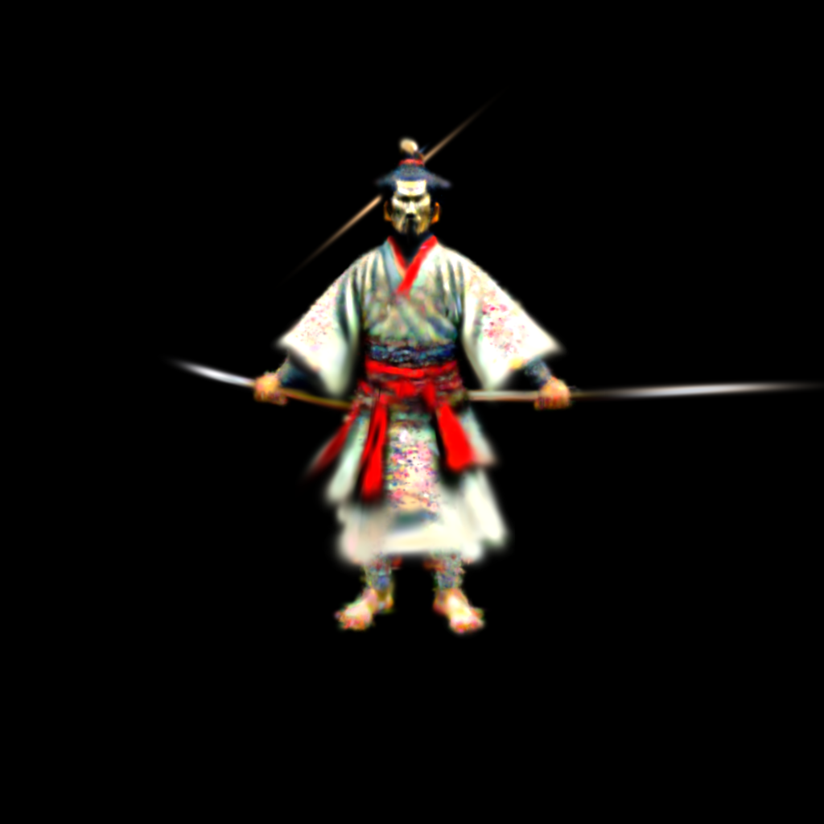
Tip details converge slowly
Iteration-1600 result comparison

Slide 12
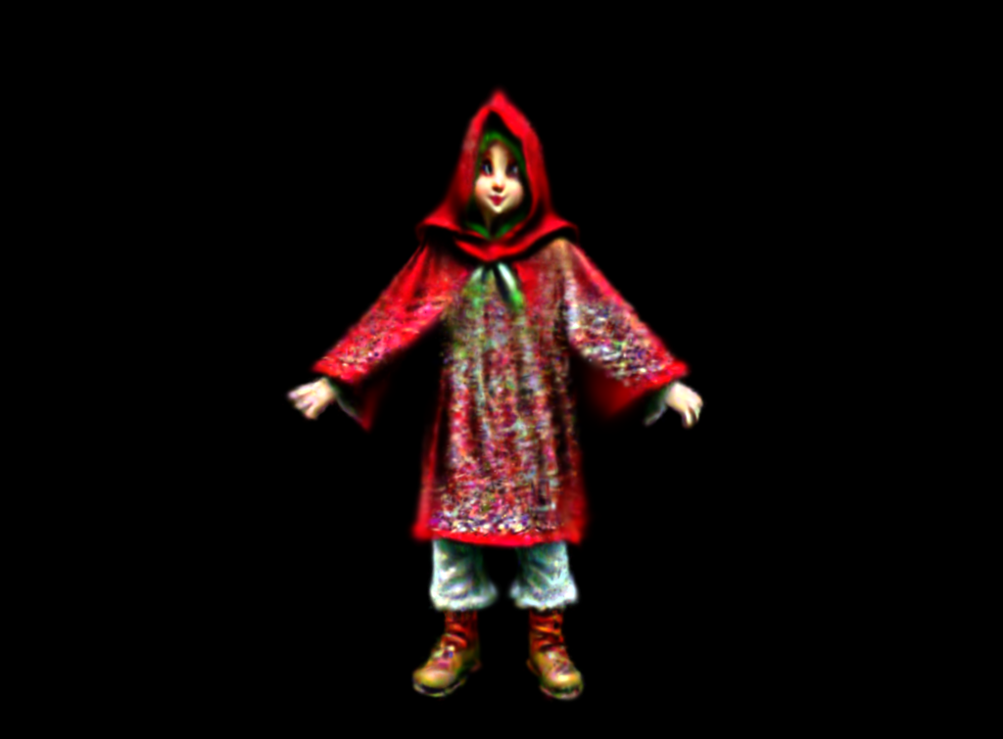
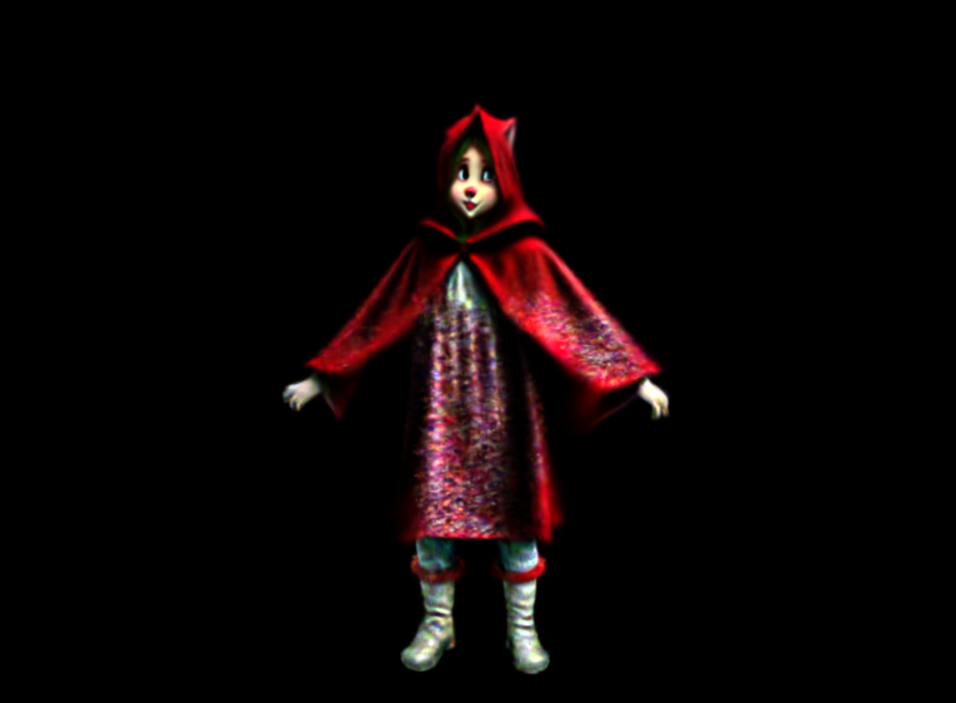
Different batch size
batch size=2
Overall, there is not much difference in the effect, but the shadow effect is more obvious when batch size=4
batch size=4

Slide 13
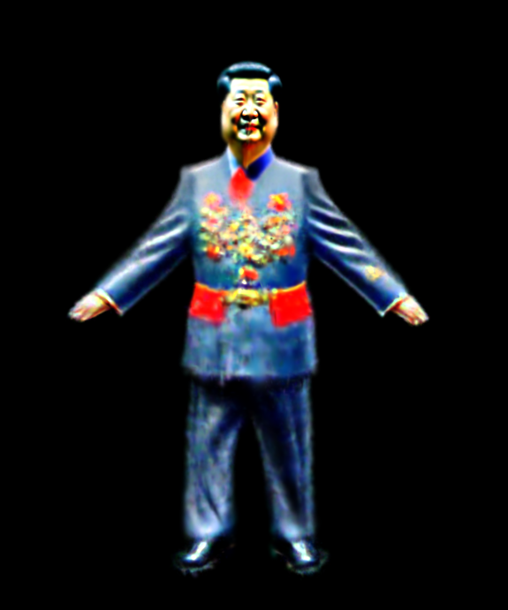
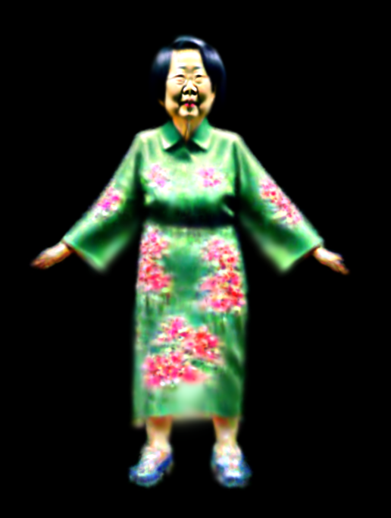
Other result
Xi Jingping
Tsai Ingwen

Slide 14
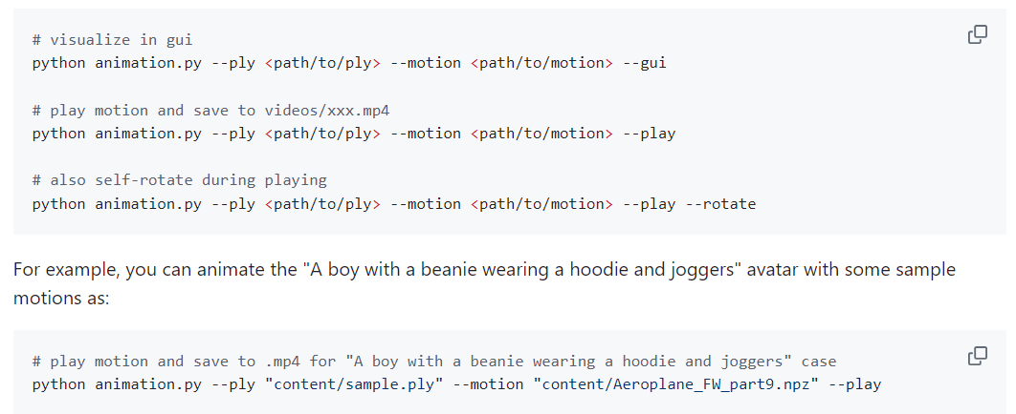
Animation

Slide 15
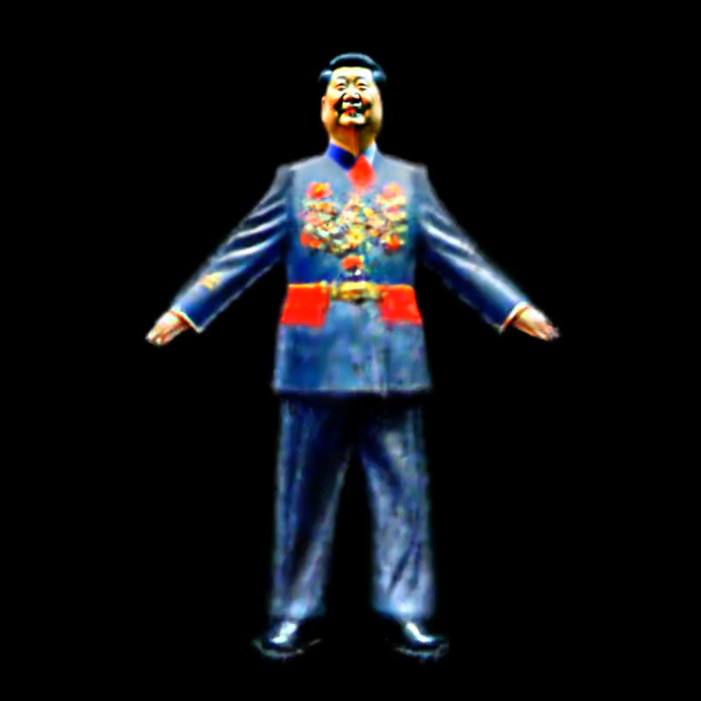
Animation result
Handsome president Xi

